Slide 1
Community Service Center of Northern Champaign County
Midpoint Presentation - BUS301

Slide 2
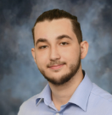
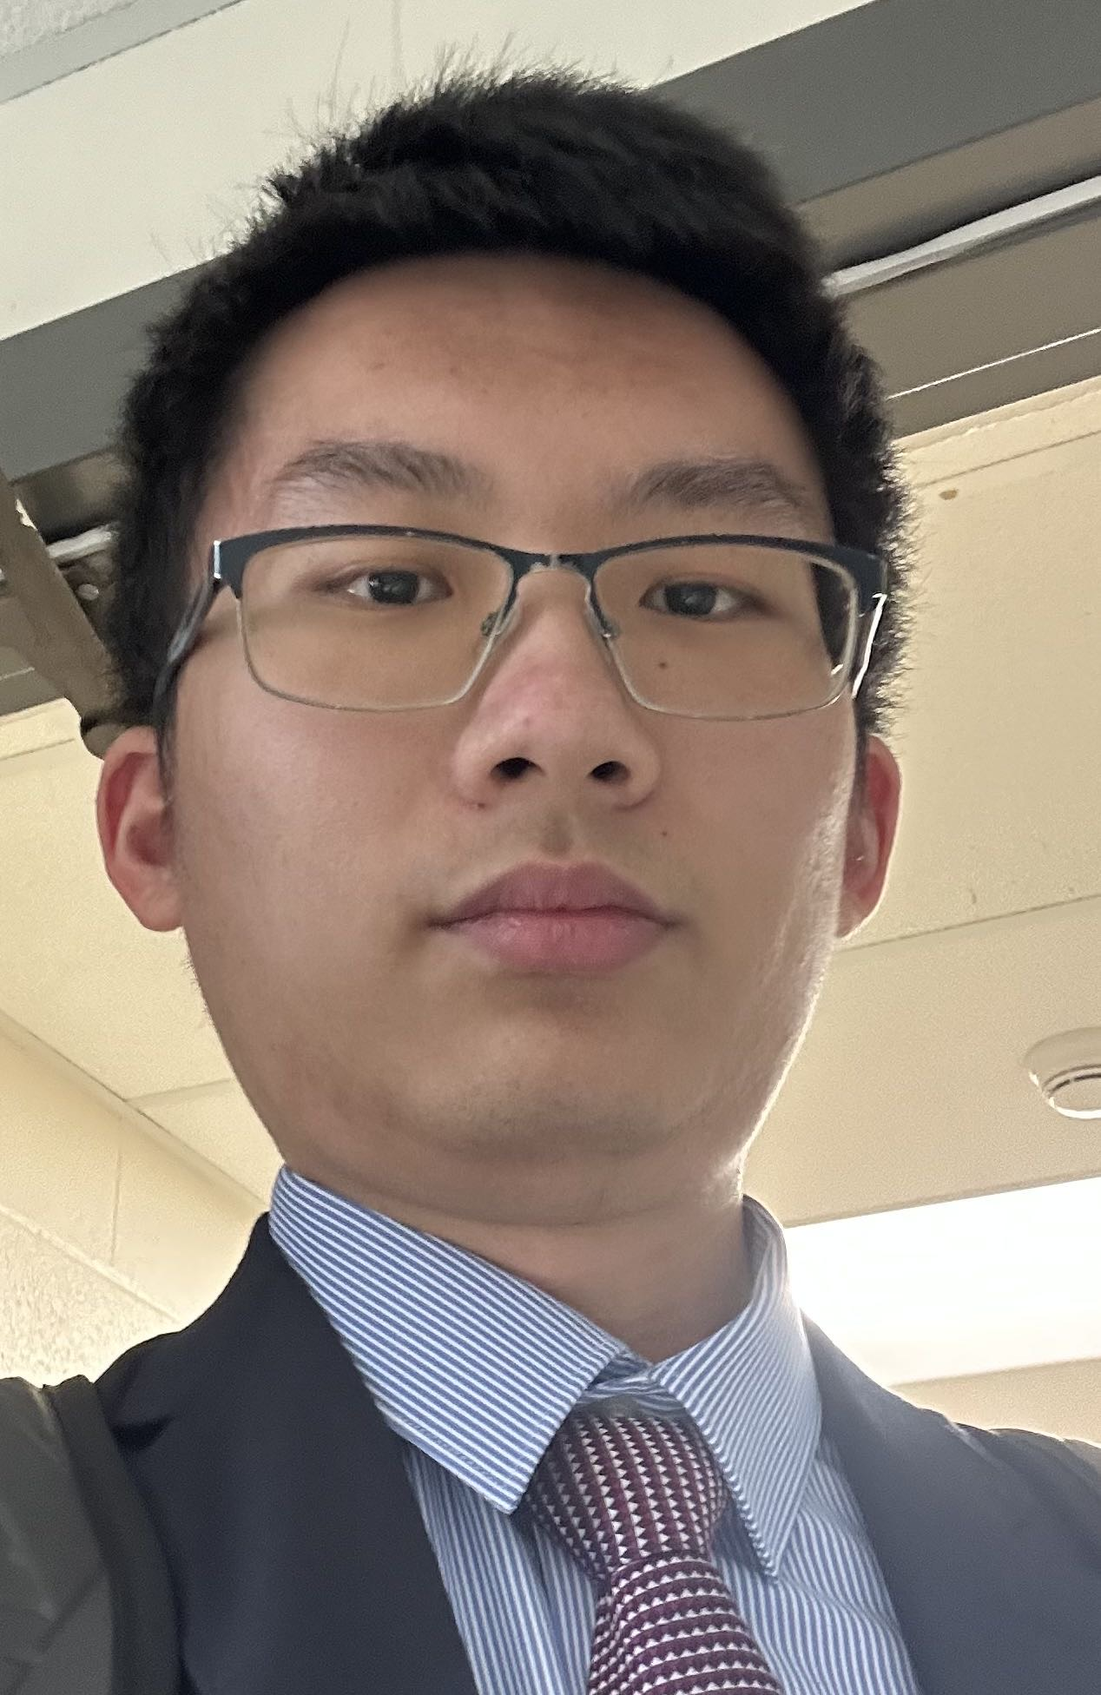
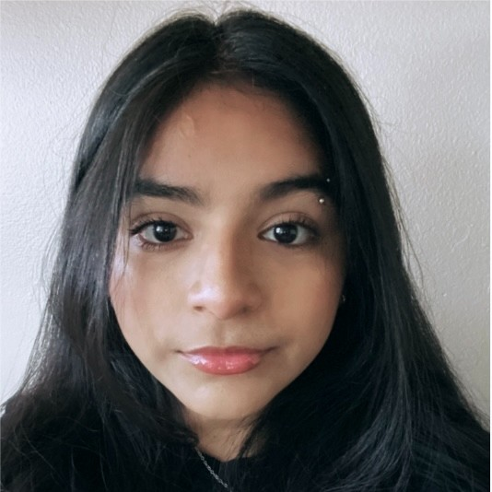
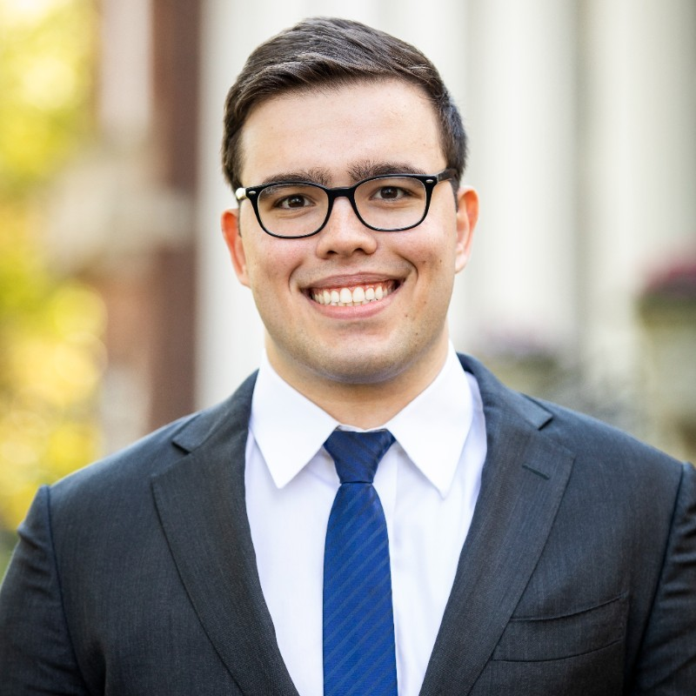
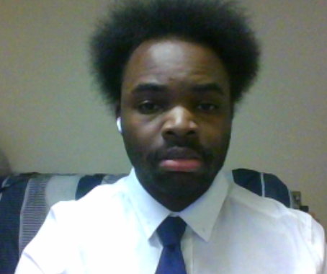
Team Introduction
Zaid Rayyan
Co-team lead, Arbitrator
Finance
Siyuan Qiu
RESEARCHER
Business Management
Samantha Romero
Researcher / note-taker
Marketing
Matt Splitstone
Co-TeaM Lead
Finance
Terrell Kellum
Editor
Information systems
Yuang Zuo
RESEARCHER
Finance and Data science

Slide 3
Agenda
Problem Statement
Donor Info
Fundraising
Moving Forward
Notes:
Problem statement and issue tree
Methodology – how we approach the issue
Research, workstreams
Moving forward

Slide 4
Problem Statement & Issue Tree
How can CSCNCC implement marketing strategies to attract a larger donor base?
Donors
Marketing
Financial
How can we introduce ourselves to and attract new donors and volunteers?
What strategies work best with different ages?
What similarities do we see than can cater to different age groups?
Who are donors and why do they donate?
How can the donor base be segregated?
Where do opportunities for greater retention and engagement exist?
How can we increase revenues?
• Can we expand current revenue streams
• How can we increase ROI?
By understanding the donor base, financials, and the various marketing strategies available, CSCNCC can grow its donor base.
Notes:
Problem Statement & issue tree
Matt

Slide 5
Current Donor Info
Current Donors
Most Current donors fall within the 60+ age range
Over 50% are 60+
Only 17% are younger than 60
33% from businesses
Most of the current events center around this age range, which helps CSCNCC retain them
What should we do to raise this number?
Notes:
terrell

Slide 6
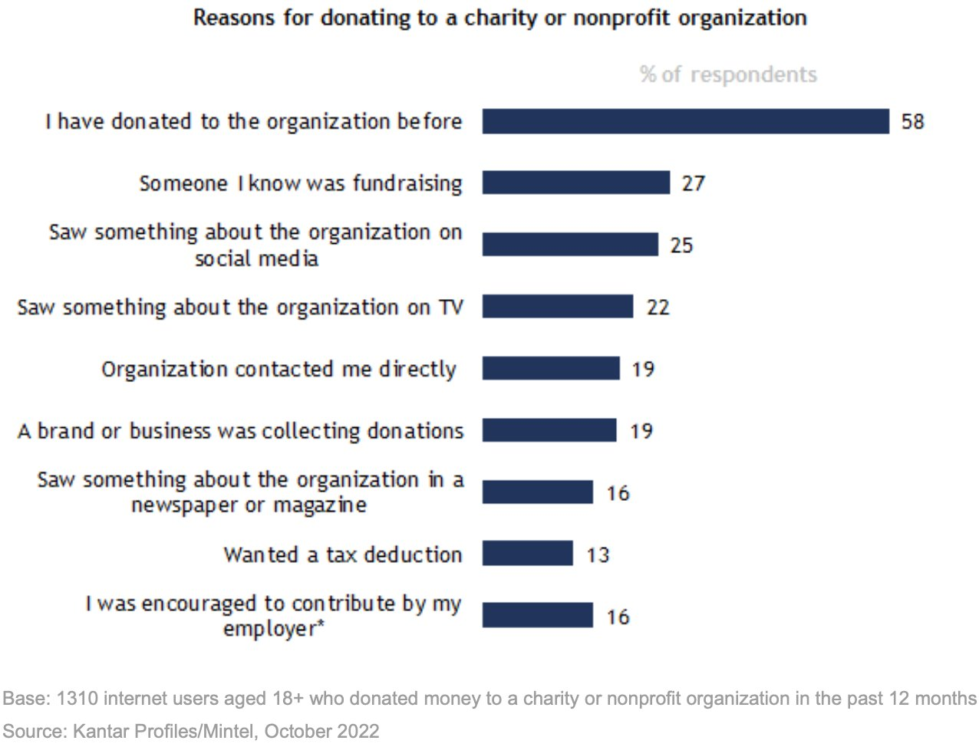
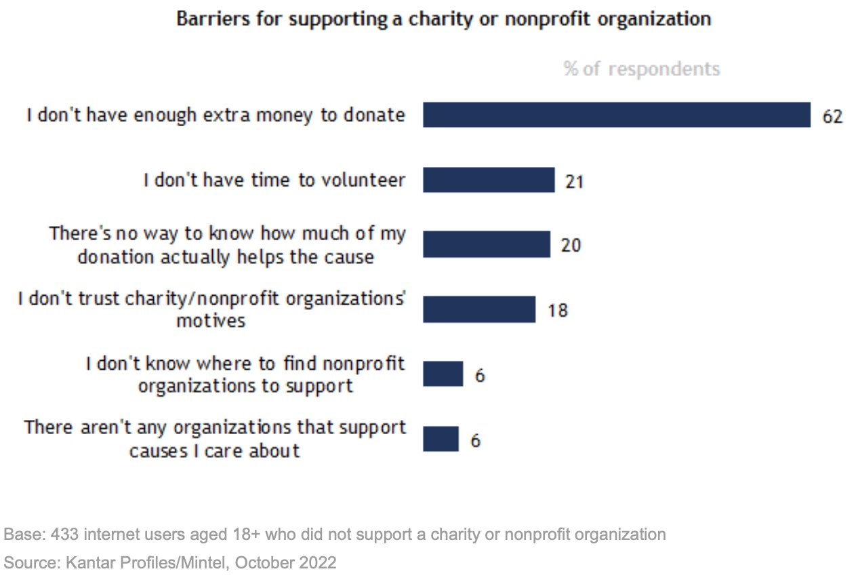
Donation Habits
What influences donations?
Engagement
Brand association
Transparency
What stops people from donating?
Disposable income
Availability
Lack of information
6
Notes:
zaid

Slide 7
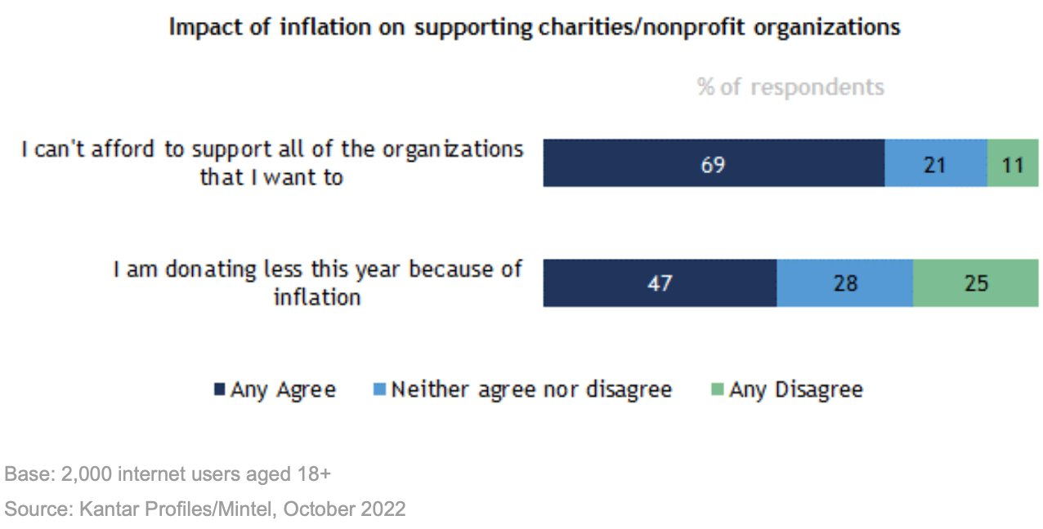
Donation Habits cont.
How can we increase donations?
Leverage available data
Utilize resources
Re-evaluate fundraising options
7
Notes:
zaid

Slide 8
Problem Statement & Issue Tree
How can CSCNCC implement marketing strategies to attract a larger donor base?
Donors
Marketing
Financial
How can we introduce ourselves to and attract new donors and volunteers?
What strategies work best with different ages?
What similarities do we see than can cater to different age groups?
Who are donors and why do they donate?
How can the donor base be segregated?
Where do opportunities for greater retention and engagement exist?
How can we increase revenues?
• Can we expand current revenue streams
• How can we increase ROI?
By understanding the donor base, financials, and the various marketing strategies available, CSCNCC can grow its donor base.
Notes:
sam

Slide 9
Why are we targeting Gen Z and Millennials
What factors led us to focus on these two age groups
Factors
Longevity
With over 75% of current individual donors being 60+, long-term profitability is jeopardized
Convenience
Gen Z and Millennials spend majority of their time online, facilitating easier outreach
Community
Gen Z likes to volunteer at organizations where they can be a part of a community that aligns with their values
Notes:
terrell

Slide 10
What motivates Millennials and Generation Z?
Millennials
Gen Z
Personalization
Connections
Long-term visions
Personal fulfillment
Community
Digital engagement
Purpose driven brands
Connections
Short-term solutions
Socially conscious
Convenience
Presence
How can we use motivators instead of interests to create longevity and influence new volunteers/donors?
Notes:
sam

Slide 11
Problem Statement & Issue Tree
How can CSCNCC implement marketing strategies to attract a larger donor base?
Donors
Marketing
Financial
How can we introduce ourselves to and attract new donors and volunteers?
What strategies work best with different ages?
What similarities do we see than can cater to different age groups?
Who are donors and why do they donate?
How can the donor base be segregated?
Where do opportunities for greater retention and engagement exist?
How can we increase revenues?
• Can we expand current revenue streams
• How can we increase ROI?
By understanding the donor base, financials, and the various marketing strategies available, CSCNCC can grow its donor base.
Notes:
Siyuan

Slide 12
Current fundraisers performance
Return on Investment
ROI vs Human Capital
A
High
B
Golf outing has the highest ROI with an average of 575% and has a relatively low human capital requirement with a high net income
Spring fling has the second highest ROI with an average of 368% with a relatively high human capital requirement
Wine pairing has the lowest ROI with an average of 206% with a relatively low human capital requirement
A
Low
C
High
Human Capital Requirement
B
C
Low
Finding fundraising events that have low human capital requirements is essential to maximizing how we can better allocate our time and budget
Notes:
siyuan

Slide 13
Donor Metrics Implementation
Donor Retention
Retention Metrics
Donor Engagement
Engagement Metrics
Measures how many donors continue to donate
High retention rate improves long-term ROI
Data can be segregated by market segment—lagging indicator, earn back donors
Software exists to automate this process
Donor Retention Rate:
Returning Donors in Year 2 / All Donors in Year 2
Gift Retention Rate:
Amount donated by retained donors YoY
Donor Lifetime Value:
Lifetime = 1/attrition
Lifetime x average annual giving
Measures the extent to which donors interact
Tracking engagement improves marketing & personalization potential
Data can be segregated by market segment—leading indicator, prevent lapses
Can track engagement on micro & macro level
Electronic / Automatic
Email open rate
Email click-through rate
Email subscription status
Website visits
Social media following
Social media interactions
In Person / Manual
Event attendance
Hours volunteered
Donation type/size
13
Notes:
matt

Slide 14
Implementations moving forward
Donors
Grow & segment donor database
Marketing
Finance
Advise on the allocation of our marketing budget
Creating content to show impact
Creating convenient and diverse forms of outreach
Leverage available donation resources
Creating fundraisers aimed towards our market audience
Better understand young donor motivations through campus surveys
Estimate new donor base composition given recommendation implementation
Discover new events with higher ROI
Next steps include understanding the feasibility and implementation of the plans in place, providing specifics to CSCNCC in each of the core issues.

Slide 15
Questions?

Slide 16
Appendix

Slide 17
Appendix
https://www.wholewhale.com/tips/5-ways-attract-millennials-donate/
https://www.jaaz.org/generation-z-and-perspectives-on-volunteering/
https://www.capitalareafoodbank.org/wp-content/uploads/2015/11/Millennials.pdf

